Slide 1
An approach to multi-task learning: task combination and decomposition in mice
Aneesh Bal

Slide 2


Humans can learn a wide variety of tasks
Transfer learning between related tasks

Slide 3


Humans can learn a wide variety of tasks
Extraction of shared similarities during simultaneous learning
Notes:
Could be interference

Slide 4





Humans can learn a wide variety of tasks
Continual learning over a lifetime without forgetting

Slide 5
Understanding the neural mechanisms of multi-task learning
Ideally, we can understand the longitudinal nature of how multiple task representations form at the level of neural ensembles and networks in the brain
Using mice, we gain access to longitudinal imaging methods, cell-type specificity, and the ability to manipulate circuits
So, I will utilize a mouse model of multi-task learning

Slide 6
A mouse model of multi-task learning
Do mice show evidence of stable behavioral performance across multiple, distinct tasks learned in sequence?
Do mice exhibit rule learning or multiple stimulus-response mappings when learning two tasks?
Can mice generalize (or “abstract out”) latent rules along each dimension of a multi-dimensional stimulus?

Slide 7




A hierarchical framework for multi-task learning
Task 1
+
Task 2
Task 1
Task 2

Slide 8








A hierarchical framework for multi-task learning
= 6kHz pure tone
Combined task
= 8-16 kHz upsweep
= 16-8 kHz downsweep
Localization
Frequency direction

Slide 9
Learning paradigms from the framework
Combined task
Skill combination
Localization
Frequency direction
Combined
Localization
Frequency direction
Task decomposition
Combined
Localization
+
Frequency direction

Slide 10
Training mice on a skill combination paradigm
Skill combination
Localization
Frequency direction
Combined
Notes:
Only have 3 mice, showing data from 1

Slide 11
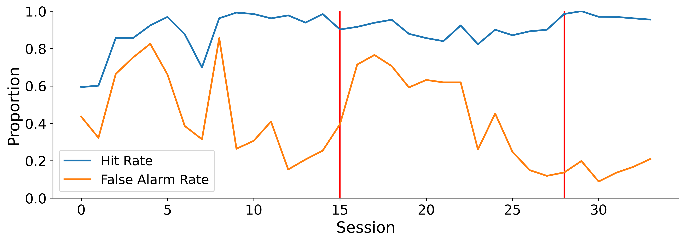
Mice show expert performance on a combined task without explicit training
Localization
Frequency direction
Combined task
Skill combination
Can you get higher resolution images? Otherwise, this looks fine

Slide 12
Training mice on a task decomposition paradigm
Task decomposition
Combined
Localization
+
Frequency direction

Slide 13
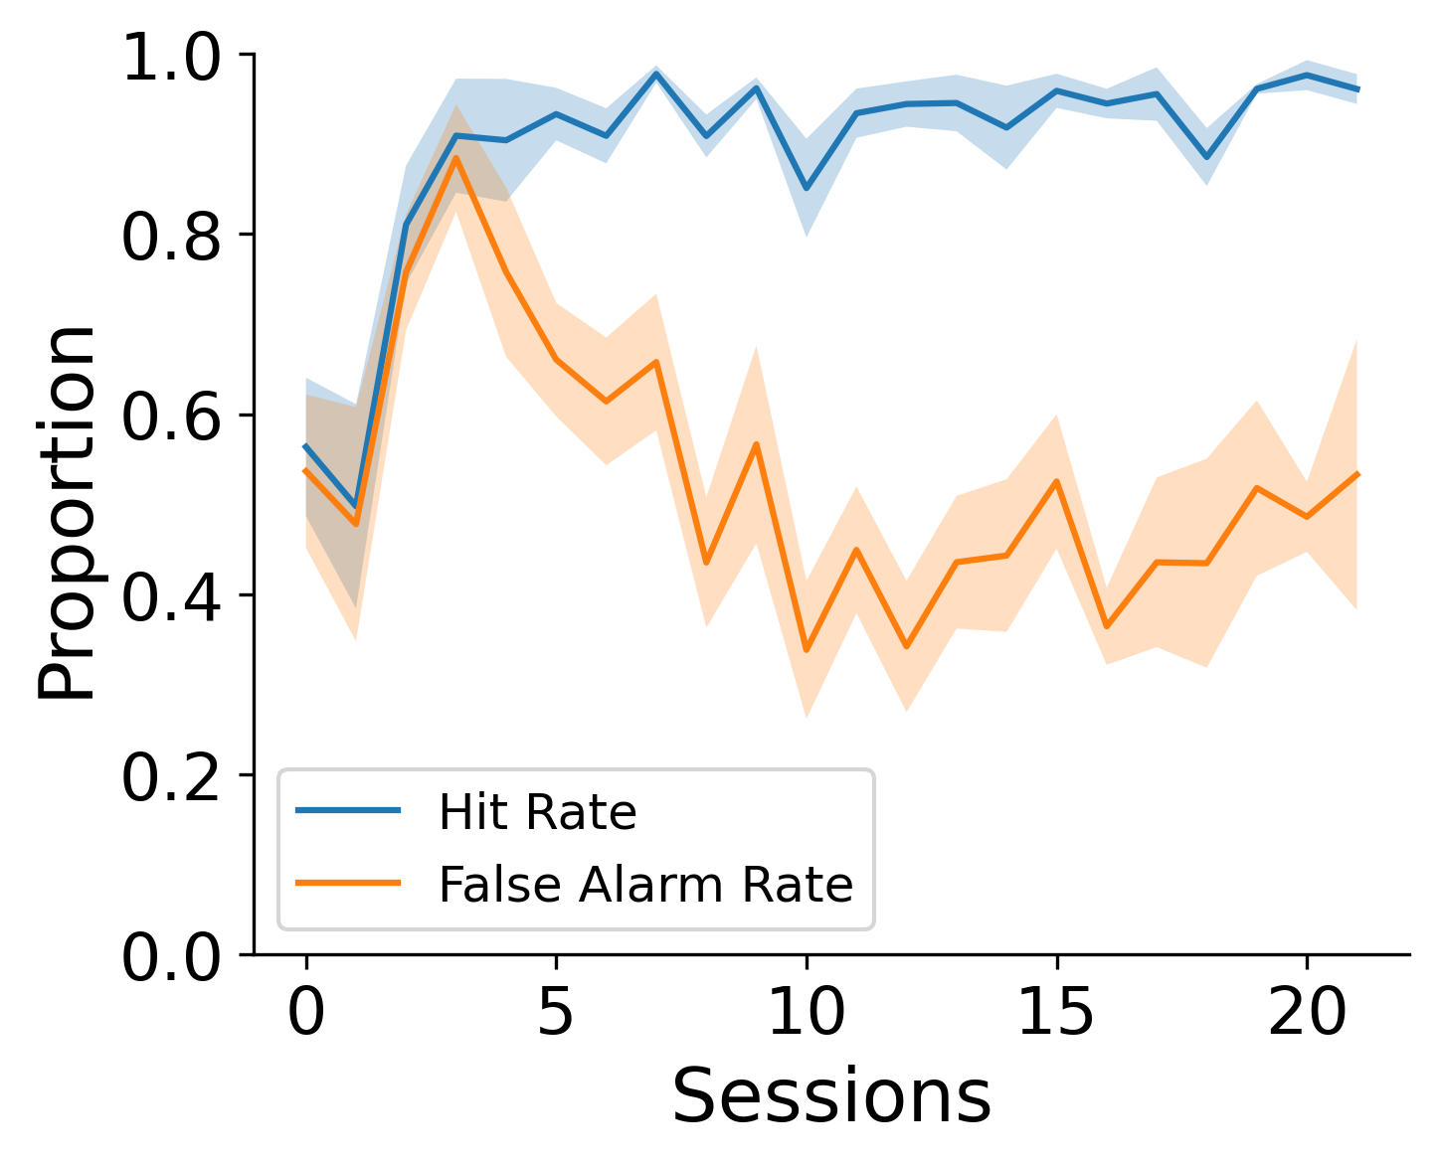
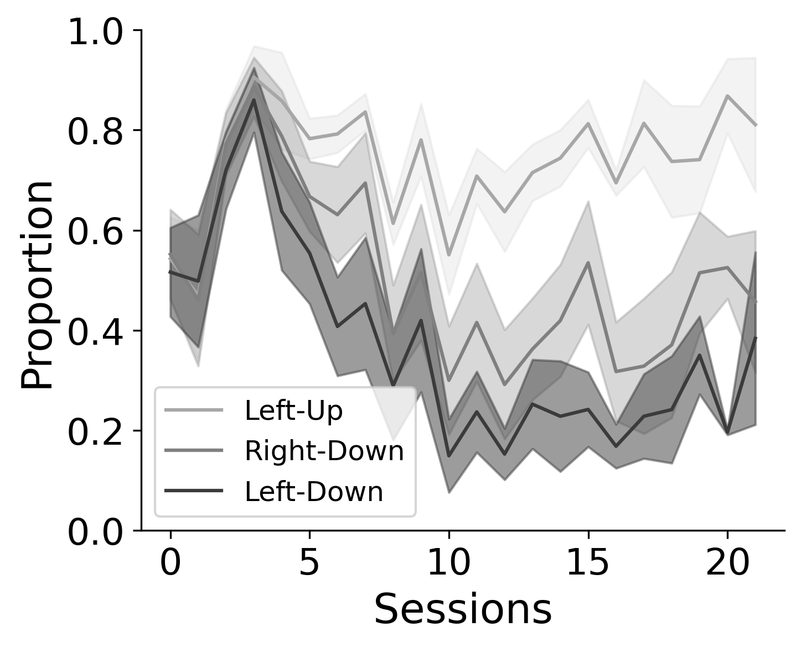
Mice show differential performance by foil type
Combined task
Task decomposition
False alarm rate by foil type
Notes:
Foil type by tone getting rejected differentially, could be preliminary evidence of latent learning?
Explain that 2 strategies could arise: stimulus mapping vs rule learning?

Slide 14
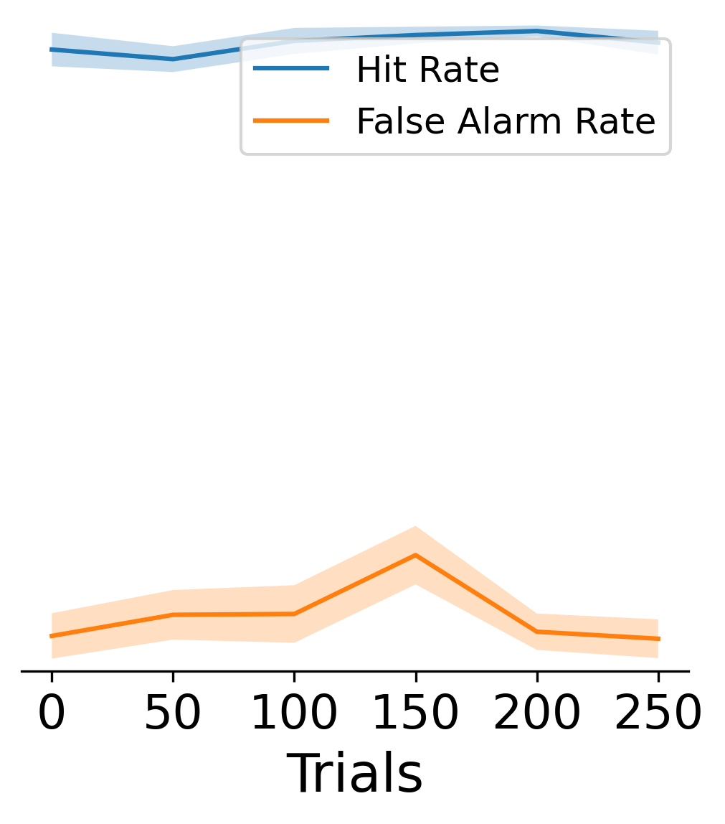
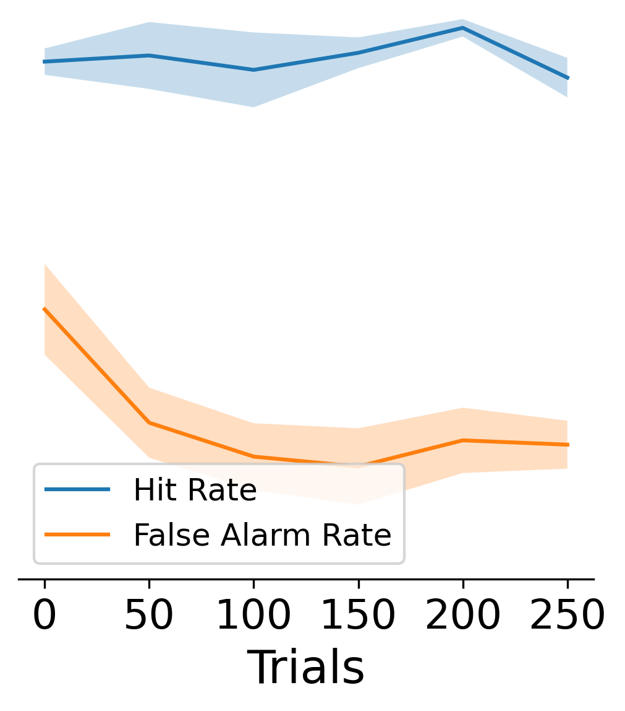
Mice show rapid learning on a localization task following a combined task
Combined task
Frequency direction
Localization
Task decomposition
Notes:
Animals have never heard a 6khz tone before, might explain high fa rate in beginning
Rapid learning of localization task
Emphasize first session

